Slide 1


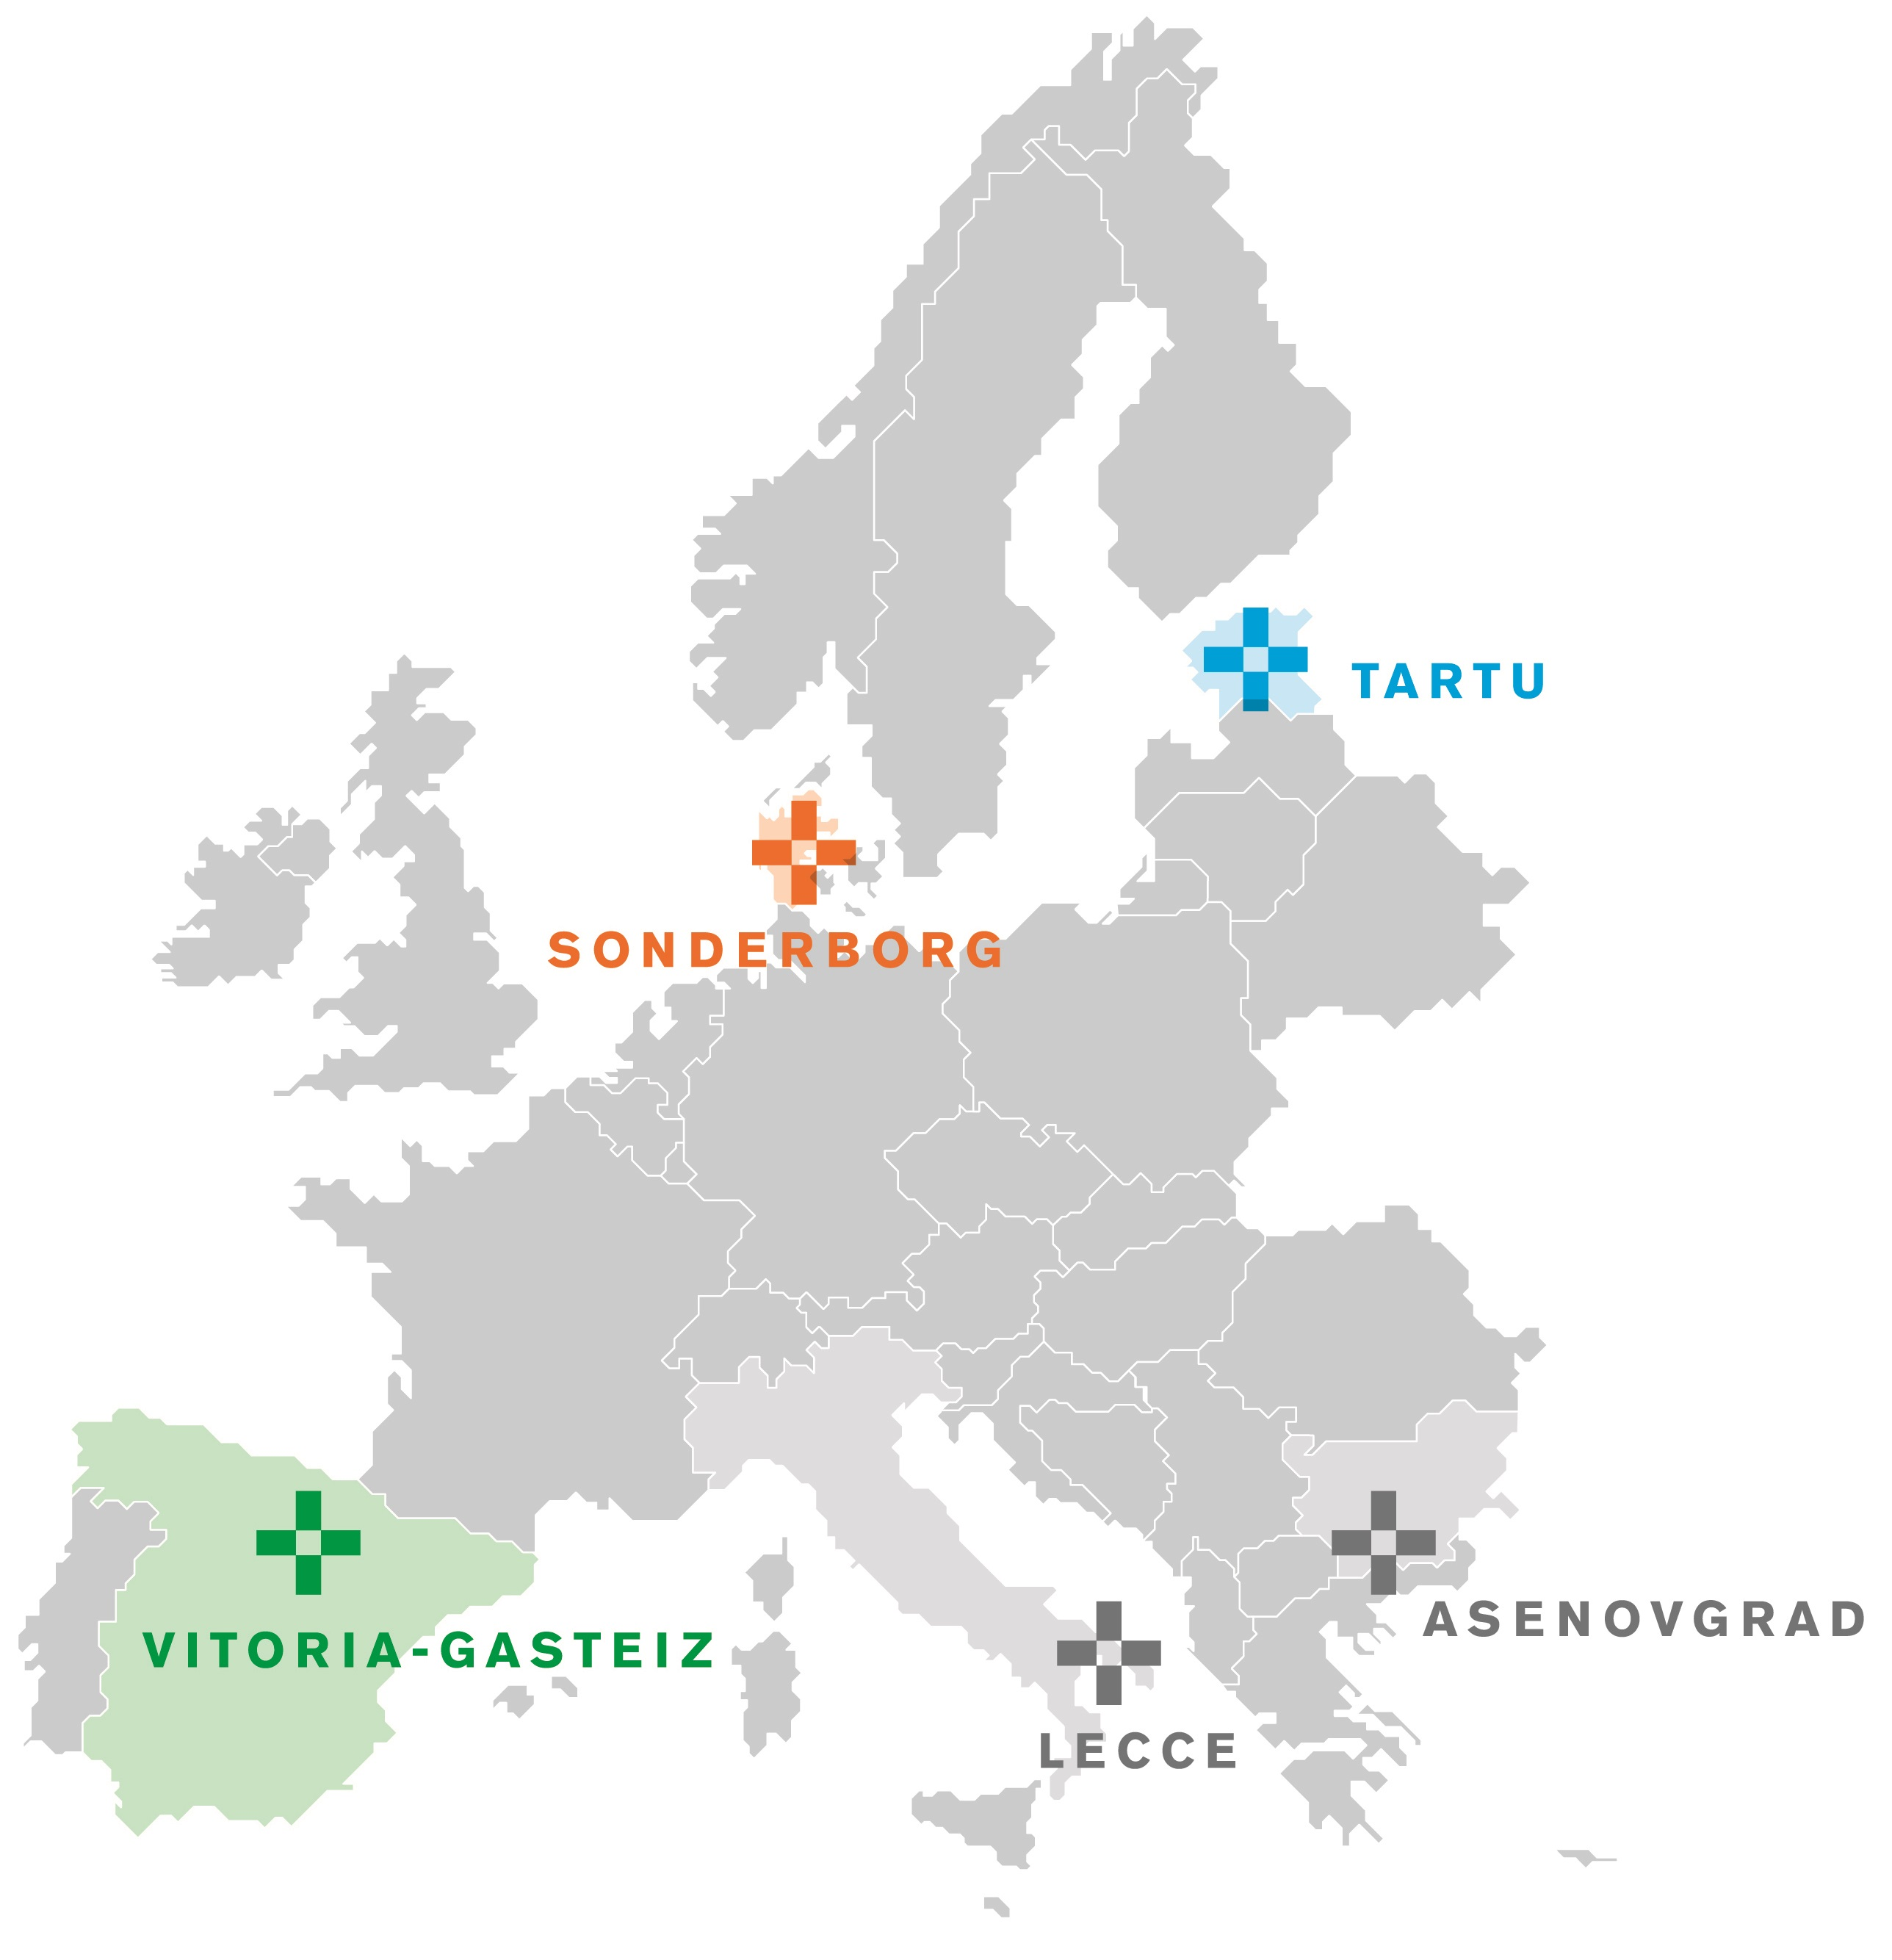
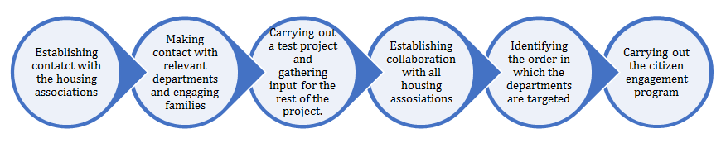
Sonderborg: Citizen Engagement
Overview
In Sonderborg, housing associations own between 25-35% of the dwellings. Therefore they have a great influence on citizens. As such, the citizen engagement program in Sonderborg focuses on housing associations and is carried out in four main steps:
Step one:
establishing a good relationship with the general managers of the housing associations, and
good communication with all departments of the housing associations.
Step two:
compiling a team to contact the tenants;
preparing a program for citizen engagement in cooperation with the team, and
good communication between the planning team and the tenants.
Step three:
involving 30 families in the project to start with,
building an IT platform to track the tenants’ energy consumption, and
a program for other departments to use the experience of these 30 families.
Step four:
Launching a citizen engagement program for all housing associations, and
scaling up the citizen engagement activities reaching all tenants by targeted communications.
Process
Citizen Engagement
This solution is specifically designed for engaging housing associations and tenants in retrofitting activities. One of the main events are workshops for the tenants, enabling them to learn more about their own energy consumption. Their awareness of energy consumption will increase and it is expected that they will become more interested in energy retrofitting the apartment buildings
Benefits from creating the project:
Learning through small-scale projects
Establishing a platform for collaboration between the housing associations
Identifying problems in advance – making it possible to modify the project
Benefits from participating in the project (tenants)
Learning about smart consumption – lower energy bills and consumption
Higher living comfort – learning to use smart energy buildings
Behavioral change – focus on energy-efficient habits
Tenants/democracy – learning about the possibility to influence retrofitting projects
Social integration – knowledge sharing among tenants

Slide 2
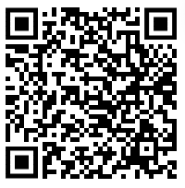
Sonderborg: Citizen Engagement
Stakeholders
Owner of the solution | Housing associations
Service/Technology Provider | IT company and ProjectZero
Users | Tenants
Investors | ProjectZero and housing associations
Investment/Finance
Human resources are the main expense in citizen engagement. The meetings have taken place at community meeting halls free of charge but catering could cause some costs.
Replication Potential
The replicability potential of this solution is high and it can be planned and implemented almost everywhere without major preconditions or barriers. However, it is critical that there is a coordinator across the housing associations.
Key stakeholders for a successful project:
Housing association administrations and organisational boards
Project coordinator
IT solution partner
Knowledge required:
Overview of the technical structure of the departments
Knowledge of educating a wide range of segments
Key point:
Create a small group across the participating housing association for identifying obstacles
Contact
Peter Rathje ProjectZero pr@projectzero.dk
More information
https://smartencity.eu/about/solutions/citizen-engagement-program-in-sonderborg/
This project has received funding from the European Union's Horizon 2020 Research and Innovation Programme under Grant Agreement No 691883.

